Slide 1



O papel das
HIDRELETRICAS na transição energética
Ricardo Gorini, DSc.
Brasilia, 29 Março 2023

Slide 2
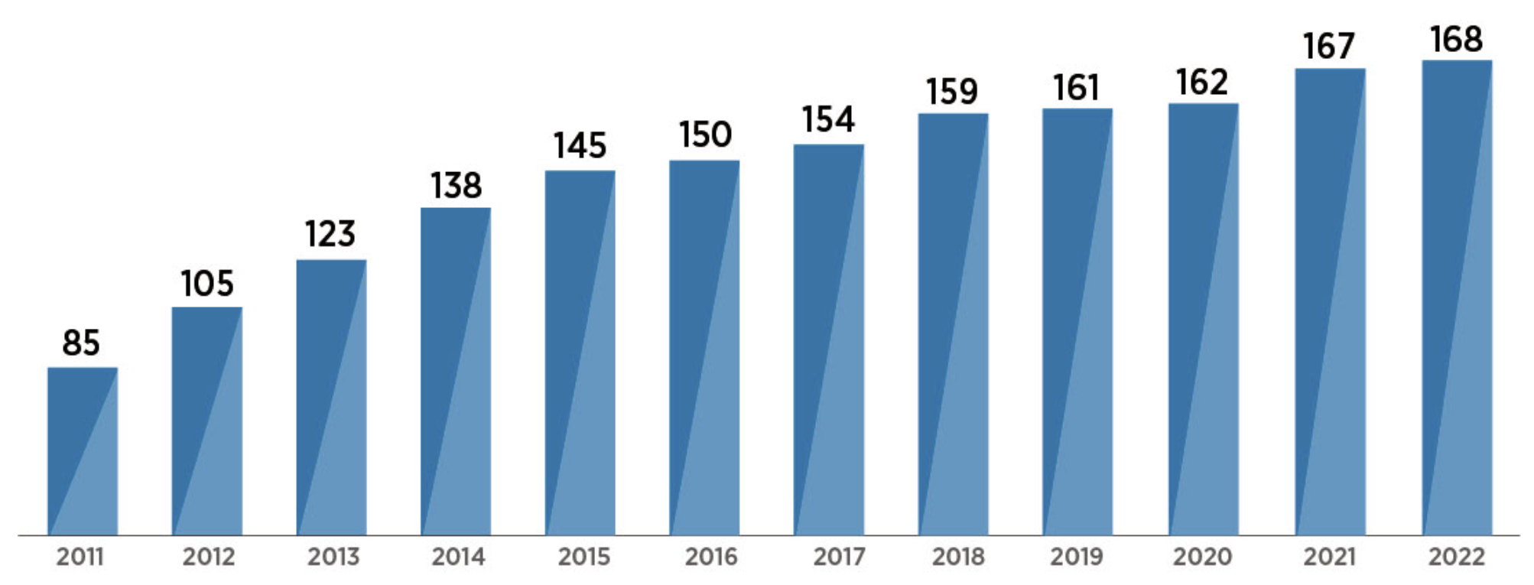
International Renewable Energy Agency (IRENA)
MANDATE
Promote the general adoption and the sustainable use of all renewable energies.
OBJETIVE
Serve as a hub for different stakeholders, as a source of advice and as the global voice for renewable energies.
SCOPE
All sustainable renewable energy technologies
168 Member states
16 States in accession
Notes:
IRENA is an intergovernmental organisation, founded in 2011 with the mandate to promote the general adoption and the sustainable use of all renewable energies. Its objective is to serve as a hub for knowledge exchange and to act as a unified voice for renewables.
IRENA is not a company, we are a public entity, funded by governments to provide them advice and promote renewables.
We have 168 Member states with 16 more in the process of becoming Members, so it is a near-global Membership.

Slide 3
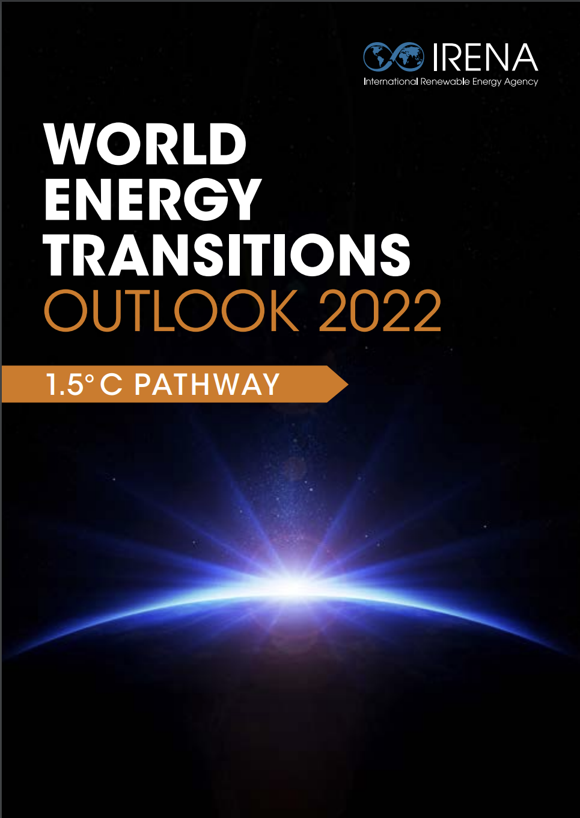
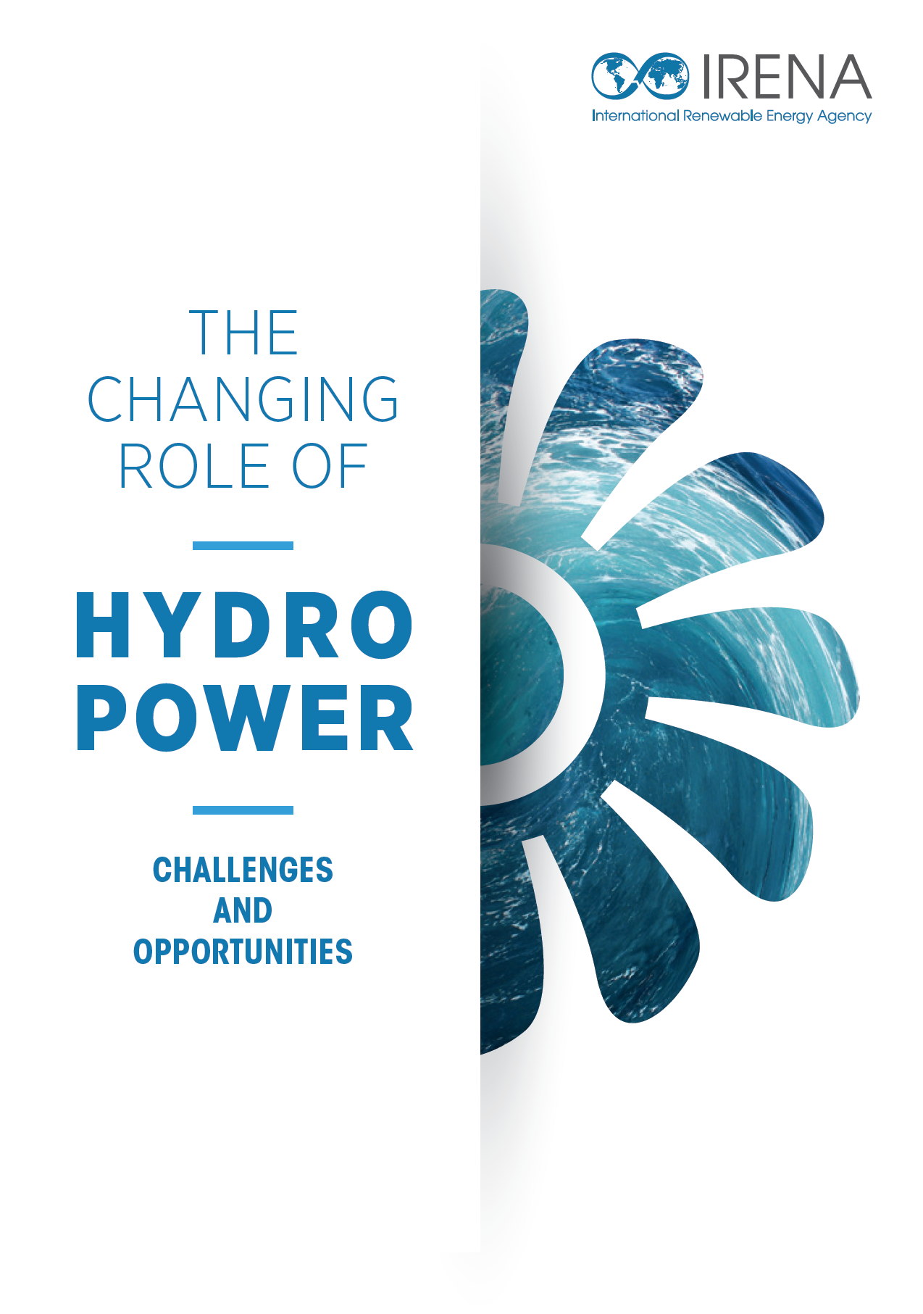

Transição Energética e o papel da hidrelétrica - em mutação
WETO – World energy transitions outlook
IRENA’s Collaborative Framework on Hydropower
Snapshot global do status das hidroelétricas
Visão de como maximisar o aproveitamento do potential.
https://www.irena.org/Publications/2023/Feb/The-changing-role-of-hydropower-Challenges-and-opportunities
Notes:
The energy transition is a massive and challenging undertaking, and hydropower is destined to play a very important role in it. However, it is currently facing a number of issues that need to be addressed if we are to maximize its full potential.
With that in mind, under the umbrella of the IRENA’s Collaborative Framework on Hydropower, we decided to prepare the report you see here, and which we are launching today, to inform our stakeholders of some of these issues.

Slide 4
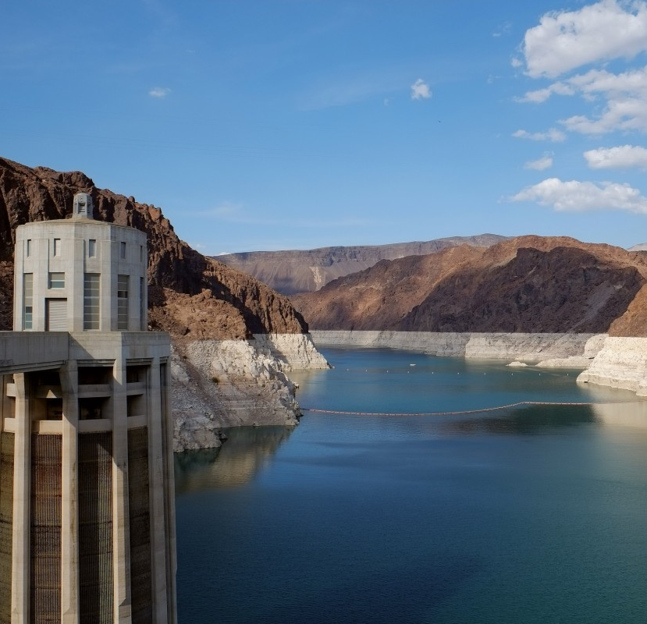
O status e o
Outlook da IRENA

Slide 5
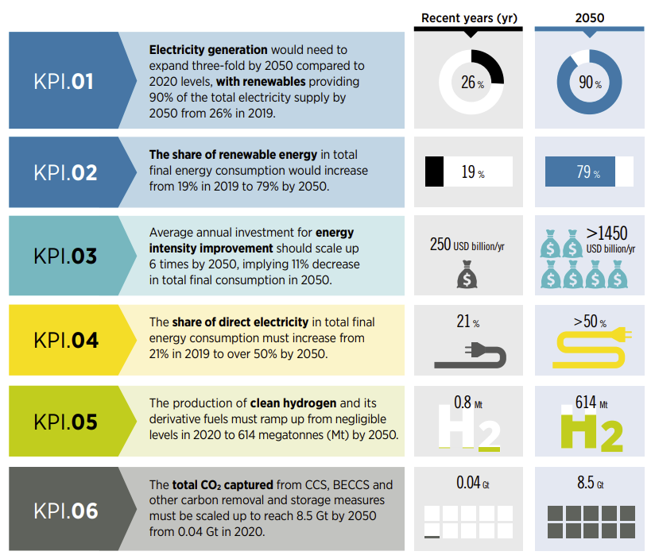
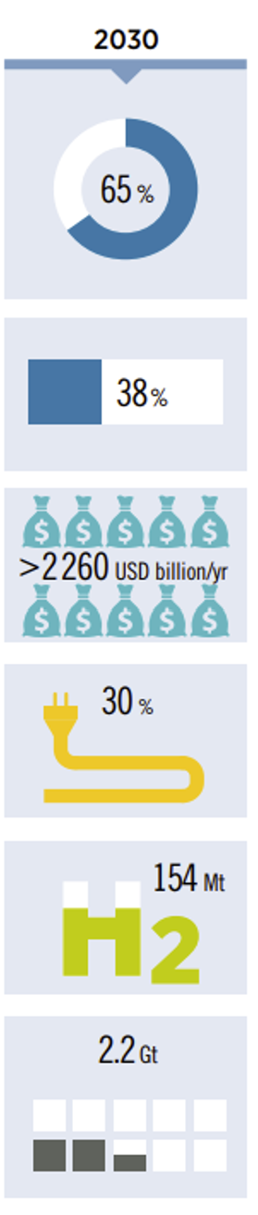
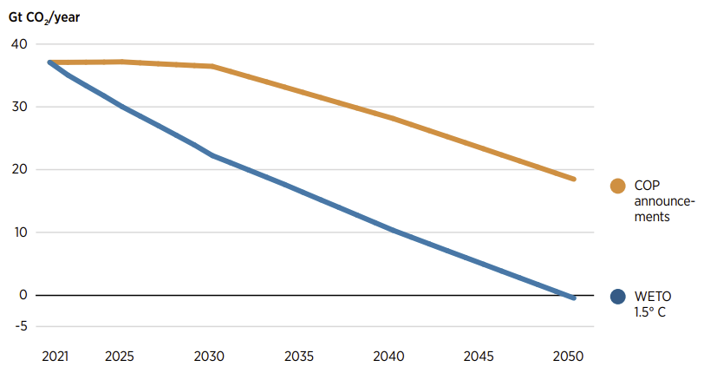
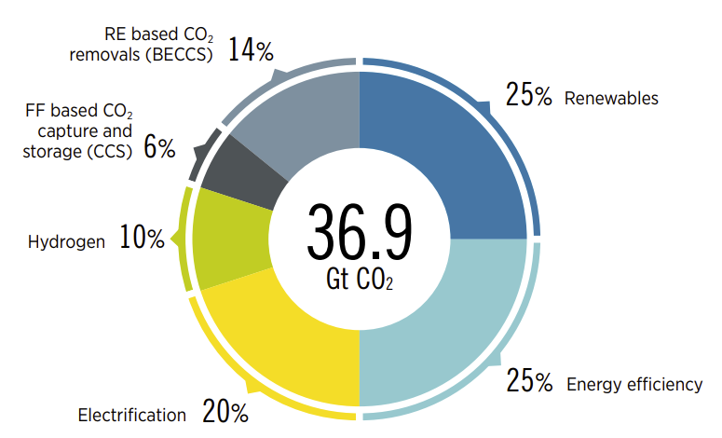
IRENA - Transição Energética Global
CO2 - trajetórias a partir dos anúncios da COP e WETO 1.5°C Scenario
WETO 1.5°C: onde precisamos estar - 2030 e 2050

Slide 6
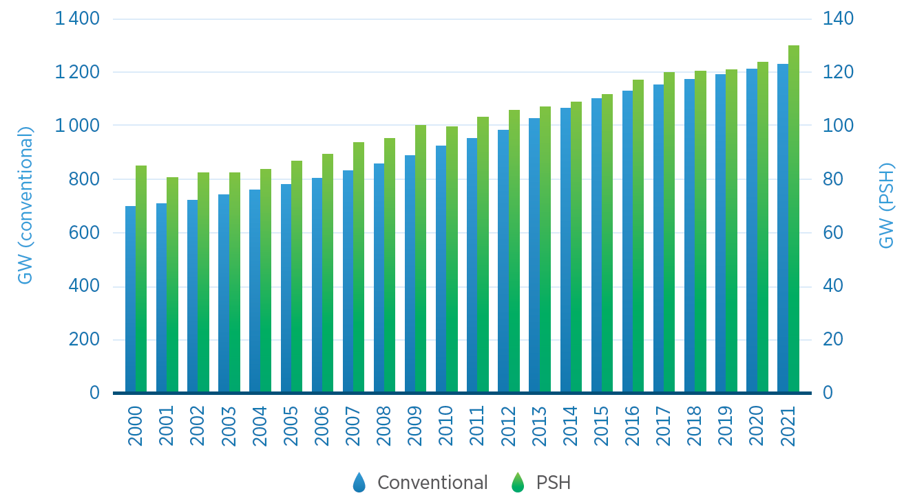
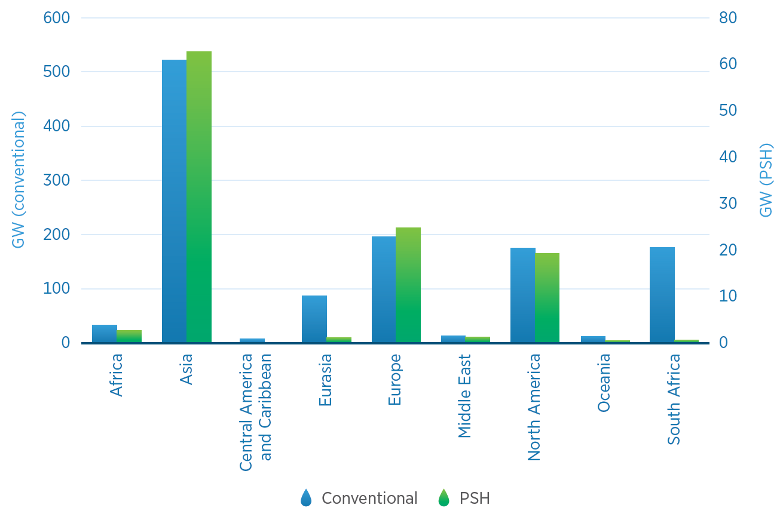
Hidreletricidade global - Onde estamos?
Hydropower installed capacity by year, 2000 – 2021
Hydropower installed capacity by region, 2021
Hidroeletricas representam a maior fonte de geração renovável globalmente. Ainda há potencial a ser explorado em particular na Asia, América do Sul e Africa.
Notes:
Hydropower is the largest source of renewable power. However, there is still room for growth with significant potential remaining untapped particularly in Asia, South America and Africa.
Conventional hydropower capacity has grown over 75% in the last 2 decades, reaching an installed capacity of over 1.2 TW. PSH capacity on the other hand has grown by over 50% in the same period, reaching 130 GW in 2021.
The majority of the world’s hydropower capacity is in Asia (42%), followed by Europe (17%), North America (15%), South America (13%), Eurasia (7%) and the rest of the world (6%).
It is noteworthy that for most regions, PSH represents between 9-13% of their total hydro installed capacity, however it is almost completely absent in Latin America, apart from a few plants in South America (< 1 GW).

Slide 7
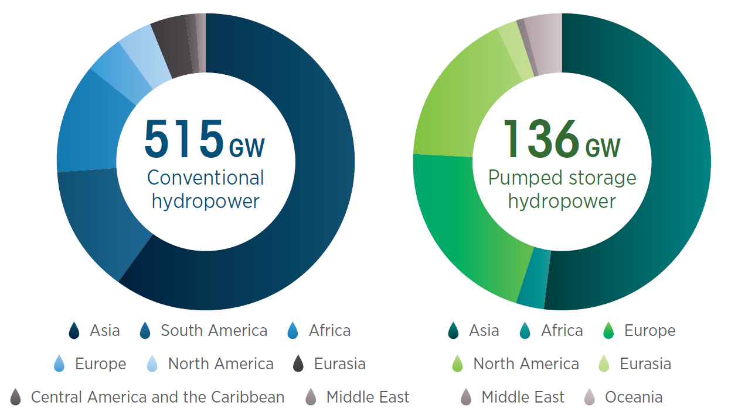
Pipeline de projetos hidrelétricos - Global
Hydropower project pipeline, 2022-2037
4%
2%
4%
4%
4%
17%
12%
52%
14%
60%
21%
3%
Pipeline significativo de projetos. Grande potencial ainda disponível.
Based on: (S&P Global, 2022)
Notes:
There are approximately 650 GW of hydropower already in the project pipeline and expected to come online in the next 25 years, including 136 GW of PSH.
The vast majority of these projects will be deployed in Asia, which accounts for almost 60% of the conventional capacity and over 50% of the total PSH capacity in the project pipeline.
In terms of PSH, Europe and North America follow Asia, with 21% and 17% of the pipeline respectively. Similar to what was observed above, there are virtually no PSH projects in the pipeline in Latina America, except for 300 MW in Chile.

Slide 8
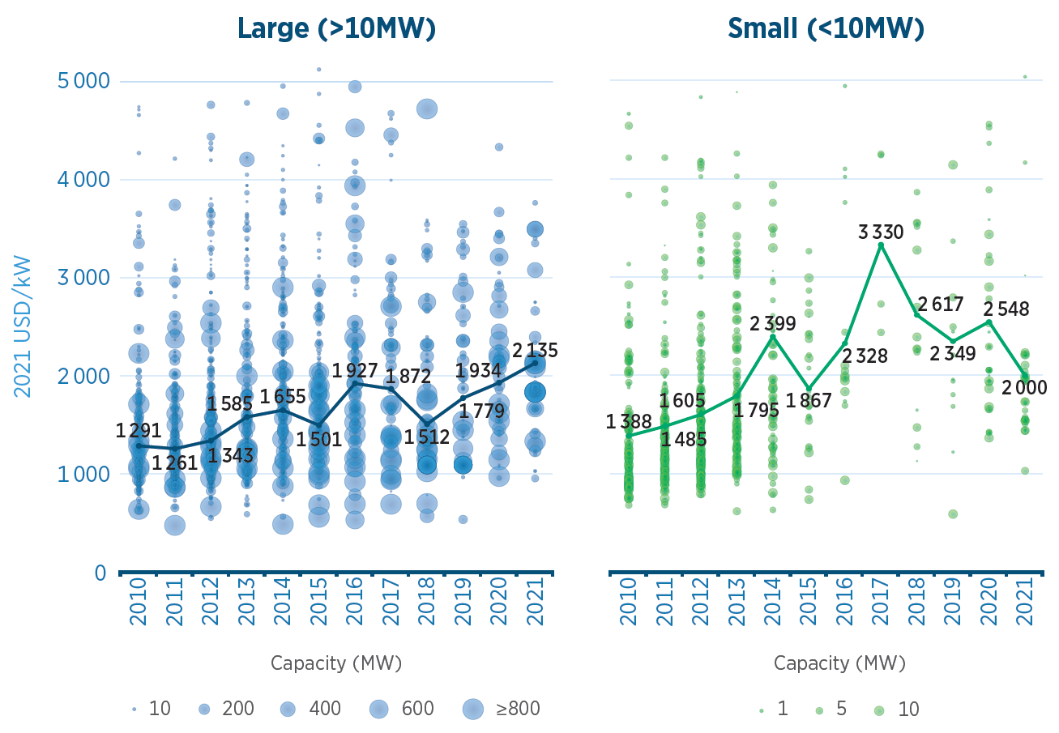
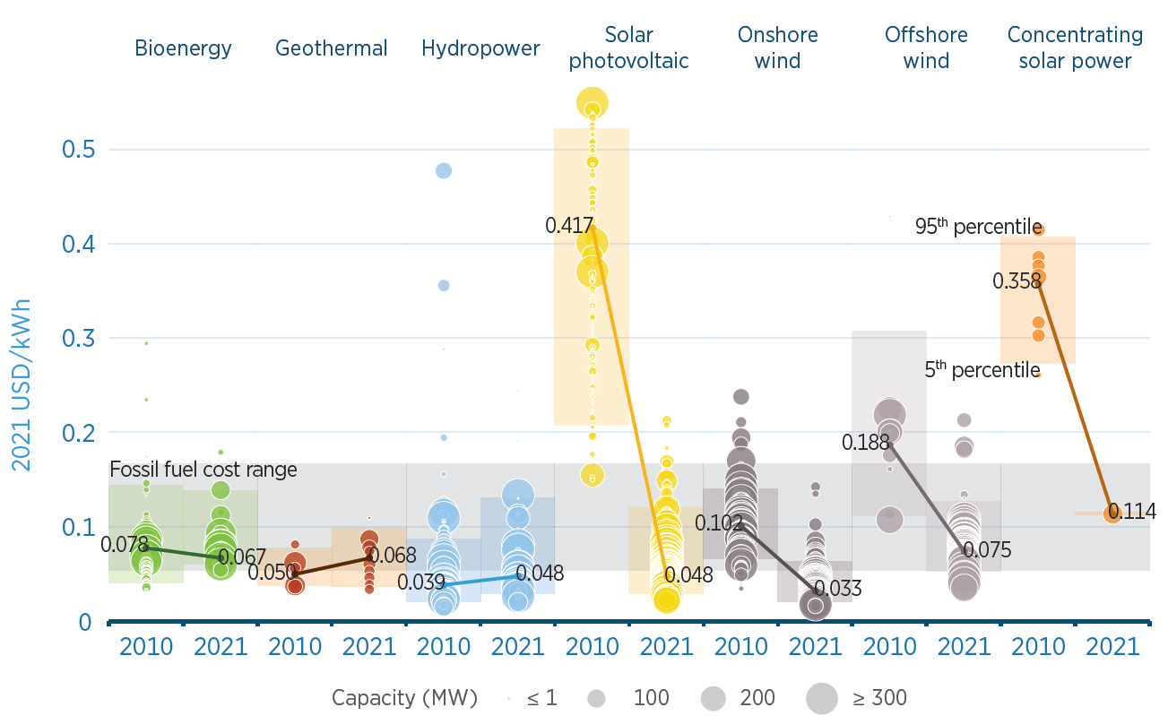
Custos – Energia hidráulica
Capital costs of small and large hydropower
LCOE of hydropower vs solar PV and wind
Apesar do aumento dos custos, ainda uma das fontes mais baratas.
Source: IRENA Renewable Power Generation Costs 2020
Notes:
Total installed costs for newly commissioned hydropower plants have risen slightly over the past decade, as seen on the left. The global weighted-average total installed cost of new hydropower in 2021 was 2 100 USD/kW for large projects and 2 000 USD/kW for small projects (roughly 30% higher).
The increase in total installed costs could be partly attributed to the fact that the best hydro sites have already been developed and countries are now trying to develop hydropower in less ideal sites, while another important component is the share of new deployments in each region, as they have different costs (e.g. total installed costs for large hydropower are highest in Oceania and Central America and the Caribbean, while lowest in China and India).
Despite being highly capital-intensive, hydropower is one of the cheapest sources of electricity. As seen on the right, the LCOE of utility scale hydropower projects in 2021 was 0.048 USD/kWh, the same cost as with PV, and only surpassed by onshore wind in this past year.
Also note-worthy is that this cost is not only amongst the lowest within renewables, but also lower than the lower cost range for fossil-fuelled generation.
LCOE values can vary substantially, first because of the investment costs, which are site-dependant, but also depending on how the plant is designed to operate (to provide base or peak load, ancillary services, etc.) and the capacity factors achieved.

Slide 9
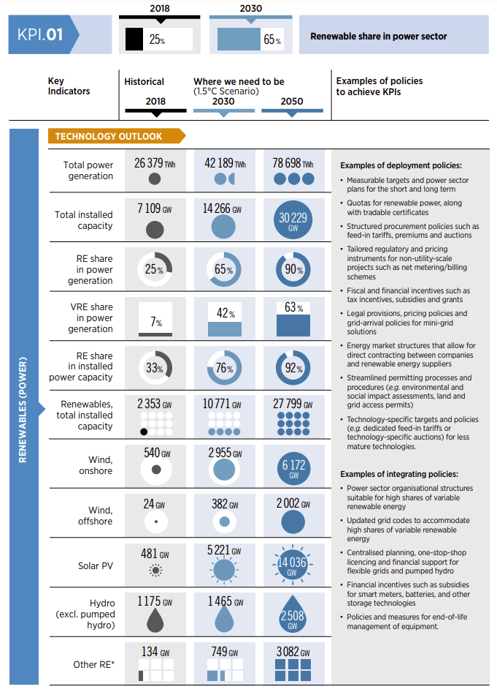
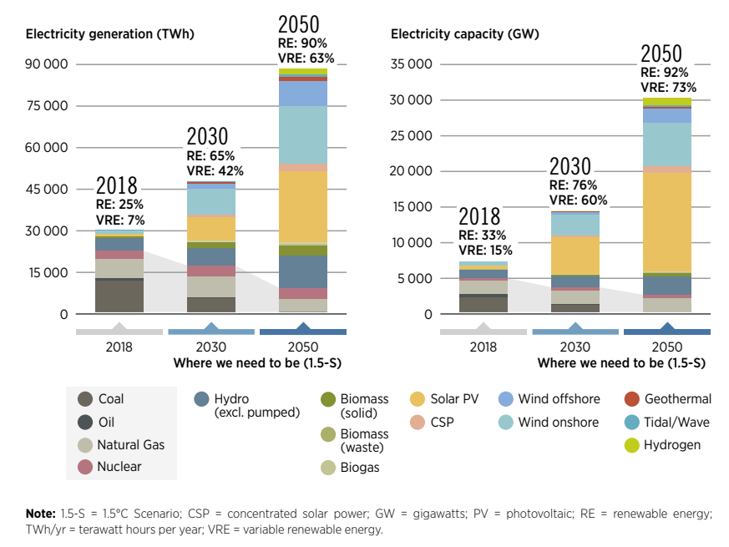
Setor elétrico global em 2050

Slide 10
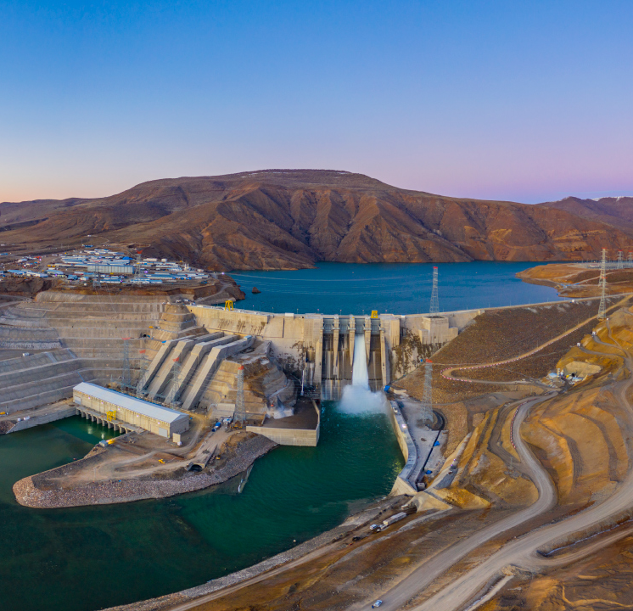
Desafios e Oportunidades

Slide 11
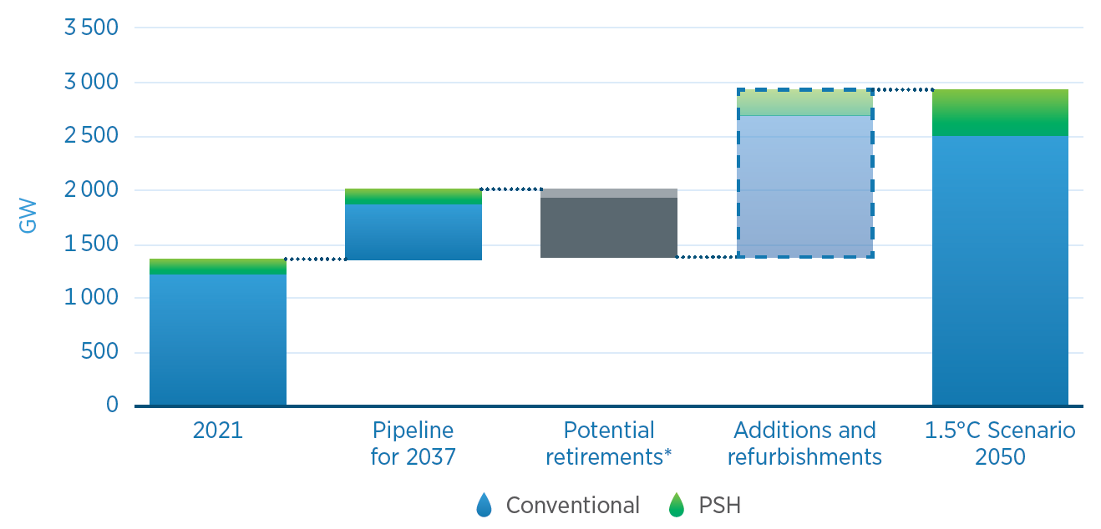
WETO: UHE – capacidade instalada esperada em 2050
Há um pipeline significativo de projetos na atualidade, entretanto para viabilizar o cenário 1.5C Paris Agreement, todavia mais é necessário.
  Globalmente há cerca de 650 GW de Hidráulicas no pipeline
  Investimento em retrofit também importante até 2050
  IRENA’s 1.5ºC scenario – dobrar atual capacidade instalada até 2050
  Principais regiões - Asia-Pacifico, América do Sul e Africa.
Necessary capacity additions by 2050 – 1.5 ºC Scenario
*Assuming an average lifetime of 60 years
11
Notes:
90% of all decarbonisation in 2050 will involve renewable energy and so we need very vast amounts of RE deployed
Global hydropower capacity will need to more than double by 2050 if the climate goals are to be achieved. This effort will investments of:
Conventional hydro - 85 billion USD/year
PSH – 8.8 billion USD/year
While a substantial amount of hydropower is in the pipeline, a similar share will be due for refurbishment or face retirement between now and 2050.
The average size of a hydropower plant in the current pipeline is 160 MW. This would mean that close to 10 000 plants need to be deployed by 2050 (320 per year), a monumental effort.
To note:
The large increase in hydro capacity is, at least in part, a consequence of the higher electricity demand, due to the increased adoption of synthetic fuels.
Even though the number is high, it is within economic and technical potential figures found in literature.
90% of the remaining potential is found in Asia-Pacific (40%), South America (25%) and Africa (24%). (9-15 PWh of economic potential, 13-31 PWh technical potential)
Not all new capacity has to come from new hydro projects.
Some capacity will could from retrofitting non-powered dams with turbines
Modernization and refurbishment efforts can also increase the capacity of existing plants, without having to build new dams.
Off-river PSH is another option that has limited social and environmental impacts
Chart numbers
GW TOTAL CONV PSH
2020 1300 1211 122
Pipeline 680 550 130
Retirements 630 550 80
Additions 1545 1297 247
1.5C-s 2900 2508 419

Slide 12
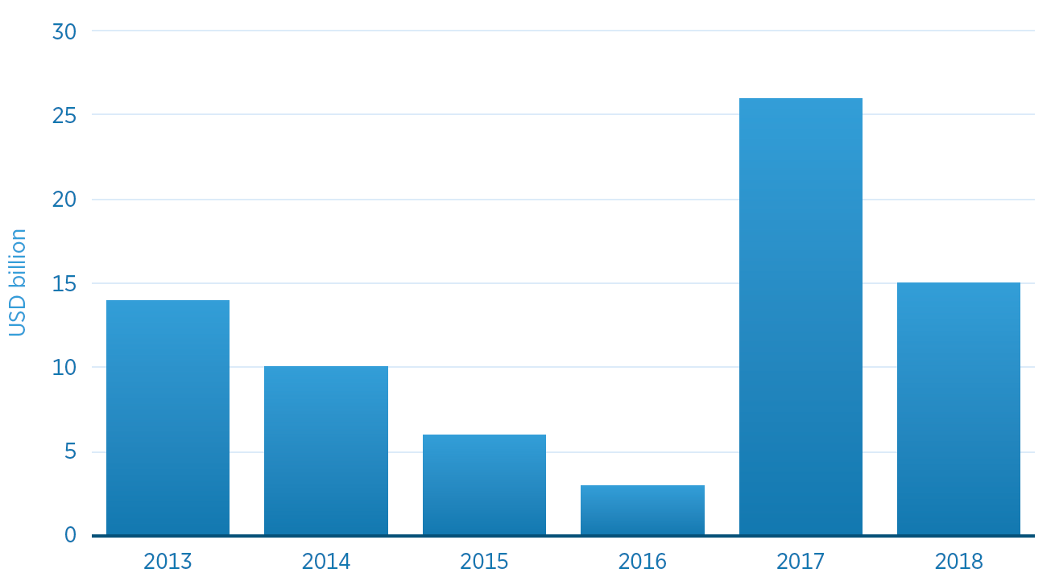
Global – Investimento necessita aumenar significativamente
Annual financial commitments in hydropower, 2013-2018
  WETO - investimentos em energia hidrelétrica em torno de 85 bilhões de USD/ano.
  CINCO vezes mais do que em 2018.
  Desafios:
  Capital intensivo e especificidade do local
  Preocupações sociais e ambientais
  Incerteza regulatória
  Valuation inadequado
  Falta de projetos financiáveis - bankable
Source: (IRENA and CPI, 2020)
Notes:
There will be a need for massive investments in hydropower in the coming decades.
The figure here shows the annual financial commitments in hydropower between 2013-2018, which amounted to 75 billion USD.
WETO estimates necessary investments in hydropower around 85 billion USD/year. That is more than this entire 5 year period and 5 times more than in 2018.
Hydropower is more difficult to finance than other RE technologies like PV and wind due to its capital intensity, site specificity, social and environmental concerns and a lack of fully studied projects. Some of which can be addressed by governments.

Slide 13
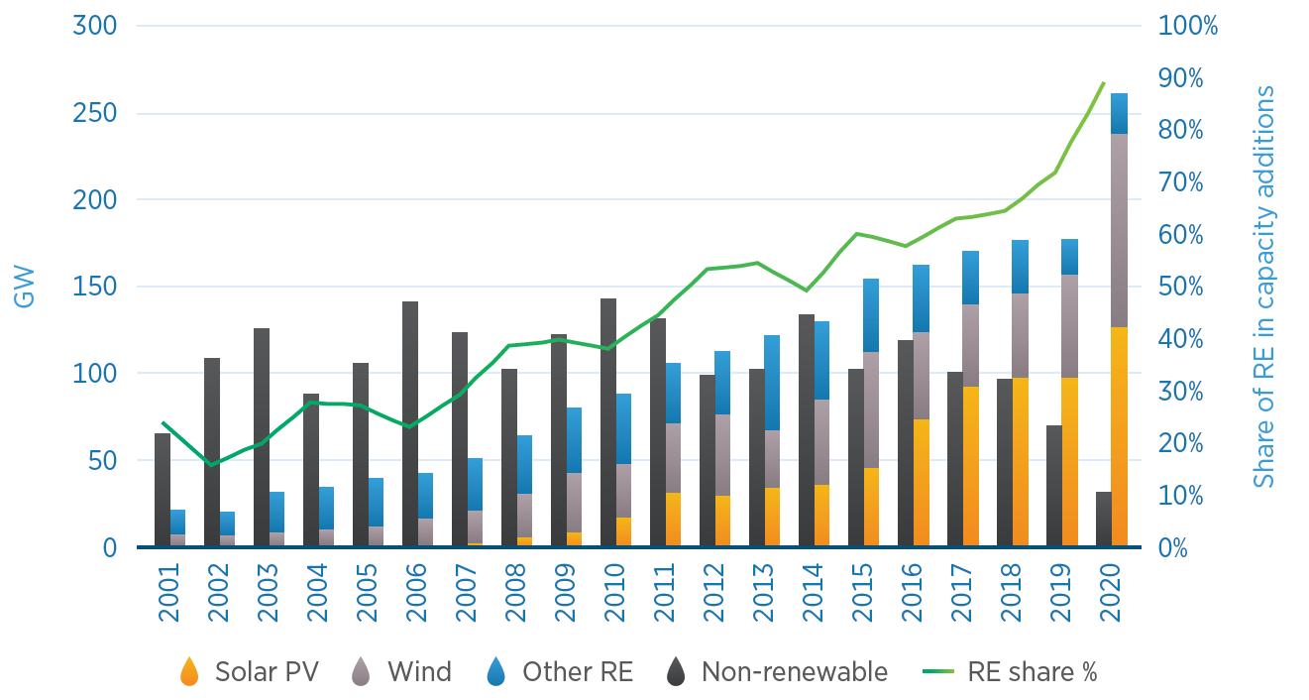
Maior % de fontes renováveis variáveis nos sistemas e o papel das hidráulicas
Inovação – na operação, na tecnologia, nas políticas e planejamento, na regulação econômica e nas regras de mercado.
  Maior % de VRE requer power systems com mais recursos para assegurar flexibilidade e estabilidade das redes.
  Hidreletricidade tem sido base dos sistemas de geração. Entretanto, esse papel tem mudado.
  A maioria das hidrelétricas foram construidas para operar sob condições distintas da atual. E isto gera consequências:
    Qual ajuste necessario na operação das usinas
    Como remunerar os serviços prestados ao Sistema
Comparison of renewable and non-renewable net capacity additions
13
Notes:
The way power systems are operated is changing. The share of RE in capacity additions keeps growing, mostly because of the exponential deployment of PV and wind techs. In 2020, almost 90% of net capacity additions were renewable, solar PV and wind technologies accounted for almost 90% of these additions. This brings its own challenges.
As more variable renewables are added to the grid, the ramping requirements increase and so does the risk of oversupply and possibly curtailment during periods of low demand.
Historically, hydropower has been a source of base load generation. However, it is more and more frequently used as peaking capacity and as a source of ancillary services.
Most hydropower plants were planned, designed and built to operate under different conditions than those of today, and therefore they are not unaffected by the changing power system.
The change in hydropower operation modes has a number of impacts:
One of them is that, it introduces additional wear and tear, shortening the lifetime of important plant components like the turbine, increasing downtime.
The other impact is financial with limited and less predictable generation, and higher O&M costs.
This highlight the need for policies and markets that appropriately remunerate the full range of hydropower services

Slide 14
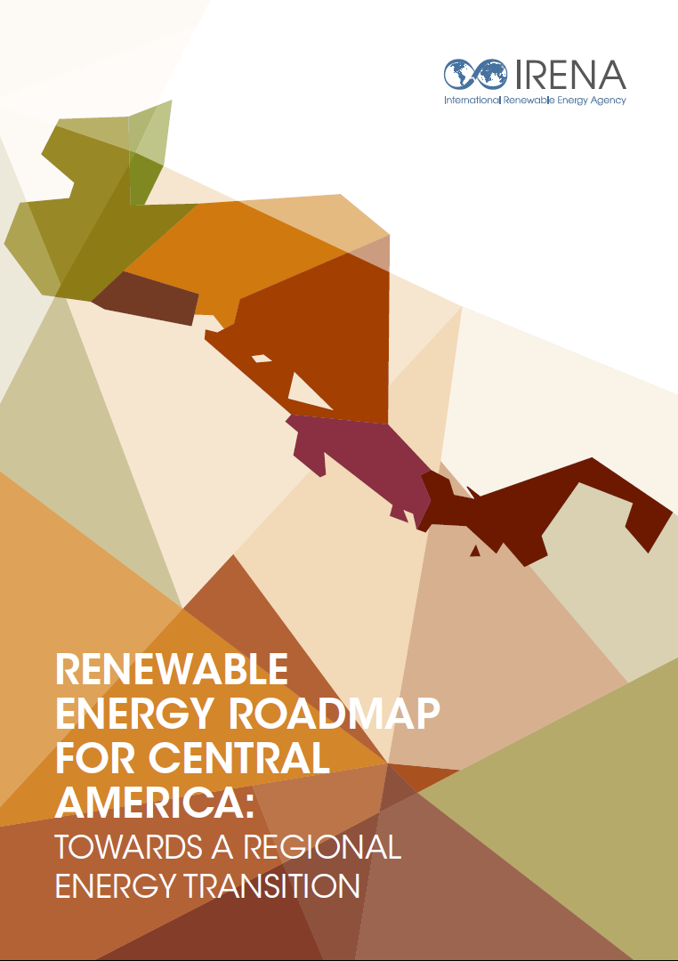
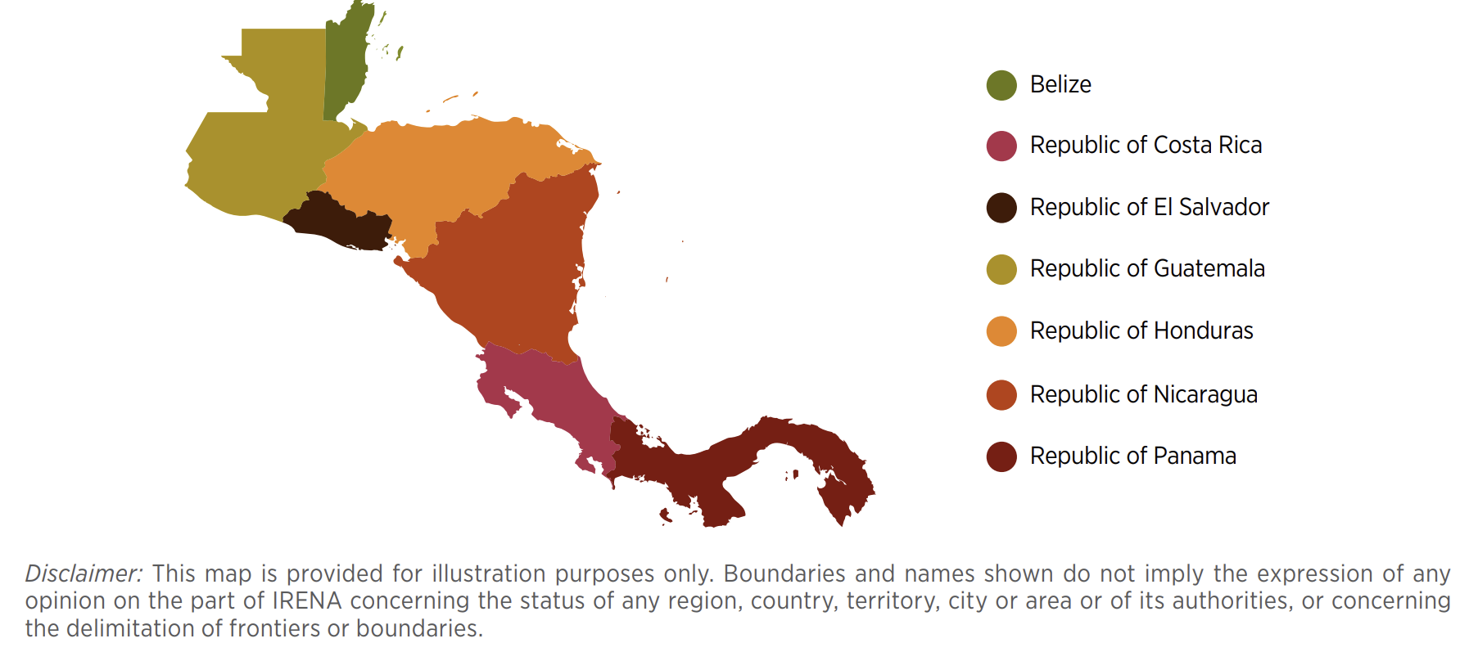
O papel da Integração regional - Ex Central America
An integrated planning of the regional energy transition is key
Sustainable mobility
Modern cooking technologies
Energy efficiency
Expansion of renewables in electricity generation
Expansion of the interconnection grid
End-use sectors
Electrification
Direct use of RE
Power sector
RE Expansion
Flexibility

Slide 15
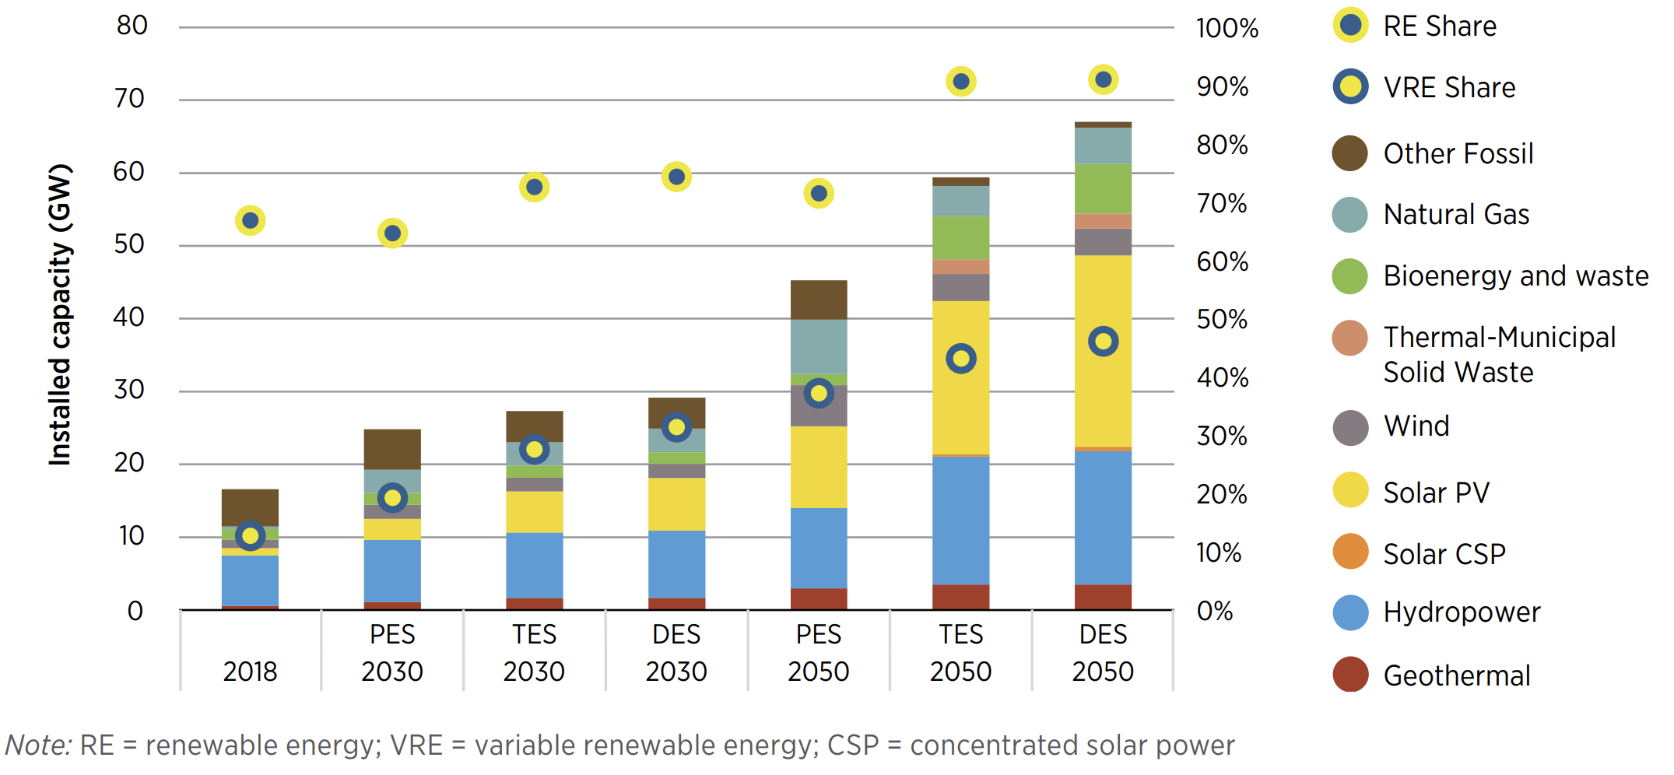
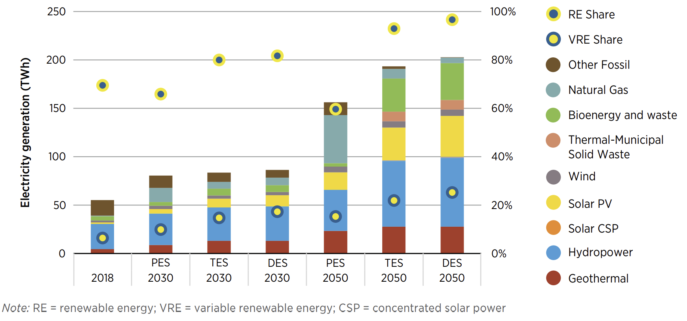
Interconexão de redes e aumento de investimento em renováveis
  Cumulative investment in new installed capacity in DES expected to be 75 billion USD
  Average annual investment in installed capacity during the period 2021–2050 of 1.3 billion USD in PES and 2.6 billion USD in DES (600 million USD estimated for 2015-2020)
Expansion of renewables in electricity generation
  Renewable installed capacity in 2018/2030/2050
  PES vs DES
  Electricity generation in 2018/2030/2050
  PES vs DES
    2030: 75% w.r.t. total (20 GW)
    2050: 90% w.r.t. total (59 GW)
    2030: 81% w.r.t. total (68 TWh)
    2050: 97% w.r.t. total (176 TWh)
  RE share
  RE share

Slide 16
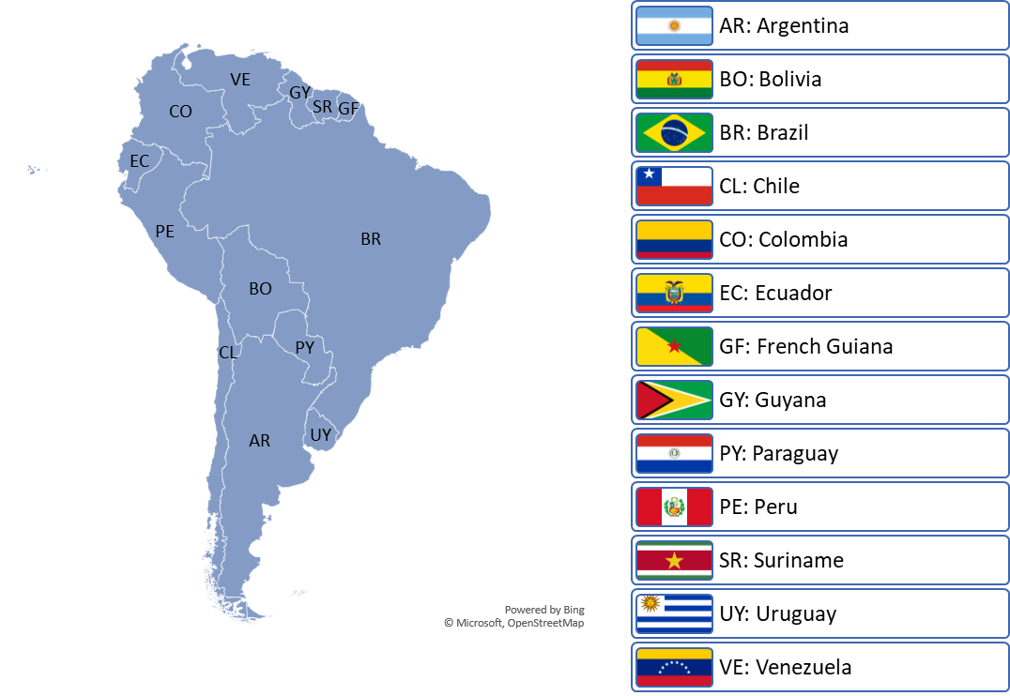
O mesmo se aplica à América do Sul – integração regional
Preliminary assessment – Q4/2022
Sustainable mobility
Innovation in industry and supply chain
Energy efficiency
Expansion of renewables (biofuels, hydrogen, electricity)
Expansion of the interconnection grid
End-use sectors
Electrification
Modern biomass
CCS/BECCS
Supply side
RE (wind, solar, hydro, others)
Biofuels
Hydrogen
Flexibility solutions in the power sector
Natural gas – role?

Slide 17
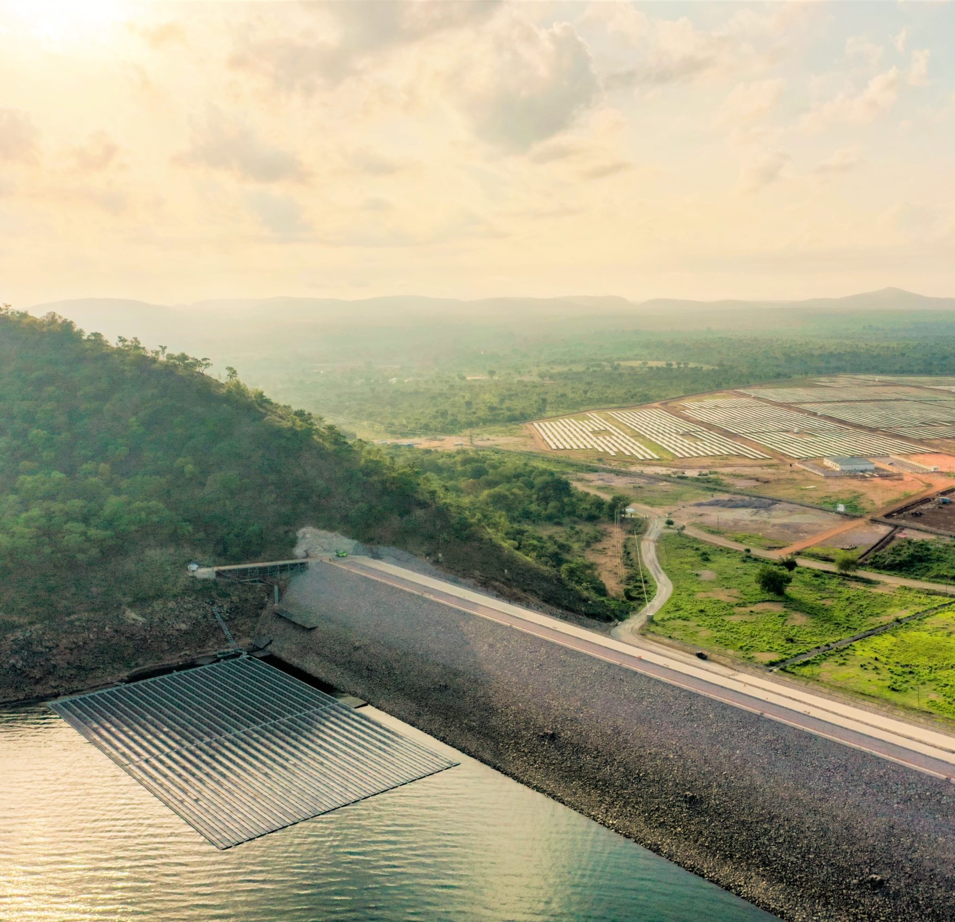
Hidrelétrica do futuro

Slide 18
Sustentabilidade como element central
  Hidrelétrica deve priorizar a sustentabilidade e a resiliência ao prestar os serviços energéticos.
  Planejamento integrado não apenas energético-eléctrico, mas incorporando requisitos de armazenamento, criterios de sustentabilidade e gestão dos recursos hídricos.
  Tecnologia disponível para a gestão da sustentabilidade, e.g. fish friendly turbines, modular hydropower, restoration hydro.
  Esforços do setor e novas ferramentas para sustentabilidade: IHA’s Hydropower Sustainability Tools and Hydropower Sustainability Standard.
Notes:
There is no excuse for the deployment of hydropower projects that are not sustainable and resilient, particularly since poor planning and management can have considerable and sometimes even catastrophic impacts on society and the environment.
new hydropower projects need to be planned and implemented prioritising the minimisation of the negative social and environmental impact without compromising their ability to generate electricity and provide ancillary and water services.
impacts of hydropower projects cannot be completely avoided. However, impacts can be minimised or offset. For example, countries considering deploying PSH assets, might want to prioritise the deployment of closed-loop systems, which have lower environmental impacts.
environmental impacts can be offset by the benefits offered by multi-purpose hydro projects. For example, research has shown that the water storage capacity provided by dams, can supply additional water for irrigation, drinking, and industrial use, as well as flood regulation, which all translate to economic benefits.
Addressing environmental impacts at the planning stage is easier, cheaper and more effective than doing so after a project has been constructed. A key element to future hydropower developments is the concept of integrated planning which looks at projects at a river basin scale and not at a plant scale and allows for the consideration of environment, water and food issues in project planning
Technology continues to improve on this front and there are international initiatives pushing for sustainability including the IHA’s Hydropower Sustainability Tools and Hydropower Sustainability Standard

Slide 19
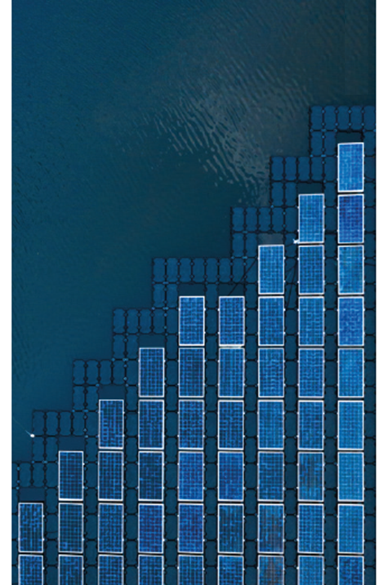
Modernização através da inovação e flexibilidade
  Usinas antigas e mudança na operação são grandes desafios, mas também oferecem a oportunidade de modernizar as usinas hidrelétricas.
  Os ativos hidrelétricos podem se beneficiar muito de melhorias destinadas a aumentar sua própria flexibilidade e, consequentemente, a flexibilidade geral do sistema.
  Sinergias adicionais podem ser aproveitadas hibridizando a energia hidrelétrica com outras tecnologias ou armazenamento VRE.
    Melhor eficiência no uso da terra
    Conservação de água
    Melhor operação do sistema
    Oportunidades adicionais de armazenamento de energia
    Melhor utilização da transmissão e redução dos custos de interconexão
    Redução curtailment
Notes:
With aging fleets and operational changes, it is time to look towards the modernisation of hydropower.
Upgrading hydropower assets with components designed for modern day operation (i.e. under wider operation ranges, faster ramping requirements and multiple start-stop cycles) and adopting innovative O&M schemes can bring multiple benefits to hydropower plants.
Digitalisation could be the foundation of this process. The digitalisation of operations can enable plants to improve the range and efficiency of their operations, reduce O&M costs and extend their lifetime.
Many hydropower plants were developed decades ago under operational circumstances that are different from today’s. This results in plants having to operate at partial loads more frequently, as well as in a substantial increase in their number of start-stop cycles. Hydropower assets can greatly benefit from improvements aimed at increasing their own flexibility and this can be done in different ways:
Plant redesign
Equipment upgrades
“Smartening” the plants
Technology has advanced greatly in the last decade, and new sensory and testing capabilities from turbine manufacturers have resulted in software which can make operations more efficient and controllable and expanding the operating range of hydropower plants. This option does not require civil works or major equipment changes.
Another option to consider is hybridization of power plants which can offer additional synergies and benefits.

Slide 20
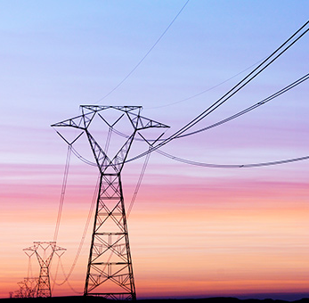
Governança, regulação e mercados precisam melhorar
  Os governos podem ajudar a atrair o investimento necessário em energia hidrelétrica, criando um ambiente de negócios adequado para isso.
  Oferecendo incentivos
    Isenções fiscais, financiamento concessional, subsídios com base no desempenho ambiental, etc.
  Simplificação dos processos de concessão e licenciamento (especialmente para pequenas hidrelétricas)
  Criar mercados inovadores que remunerem a prestação de serviços de flexibilidade e anciliares, e outros serviços
Notes:
Governments can be instrumental in helping attract the necessary investment in hydropower by creating a suitable business environment for it.
Three main pathways:
Offering incentives such as Tax reliefs, concessional finance, subsidies based on environmental performance, etc
Streamlining concession and licencing processes, reducing regulatory uncertainty and making them more attractive investments.
Creating innovative markets that remunerate the full spectrum of services delivered by hydropwoer
Important to note: neither incentives nor regulatory streamlining alone might be enough to develop the necessary hydropower capacity. A combination of closely coordinated incentives and regulatory streamlining could accelerate the deployment of hydropower.

Slide 21
Pontos de atenção
  A energia hidrelétrica está se tornando cada vez mais valiosa com base em sua capacidade de fornecer geração flexível e serviços de energia, serviços ancilares, gestão da água e benefícios socioeconômicos.
  Grandes quantidades de energia hidrelétrica (incluindo as reversíveis) precisarão ser implantadas de forma sustentável para atingir as metas do Acordo de Paris.
  A frota hídrica em algumas regiões está envelhecendo e precisará de reformas substanciais. Esta é uma oportunidade para inovar, introduzir novas tecnologias e modernizar as usinas de forma que se adequem às necessidades dos sistemas de energia atuais.
  Os investimentos precisarão quintuplicar e isso só será possível se políticas e mercados adequados forem implementados.
  A grande maioria do potencial restante está nas economias em desenvolvimento. Financiadores e governos precisam trabalhar juntos para superar os riscos e atrair os investimentos necessários.
  Novos projetos terão que ser desenvolvidos sob critérios transparentes de sustentabilidade.
21

Slide 22







Obrigado!
Rgorini@irena.org
^{www.irena.org}
^{www.instagram.com/irenaimages}
^{www.twitter.com/irena}
www.flickr.com/photos/irenaimages
^{www.facebook.com/irena.org}
^{www.youtube.com/user/irenaorg}

